Slide 1
Tusculum Experience Class Your Roadmap to Success
How to Prepare for the Search
2014-2015

Slide 2
Four Year Plan: Freshman
FRESHMAN YEAR
CAREER ASSESSMENT WILL ASSIST IN DETERMINING A PATH OF STUDY (major). TAKE TIME TO RESEARCH YOUR CHOSEN AREA OF STUDY AND COMPARE IT TO CERTAIN SKILLS, ABILITIES, OR INTERESTS.
INTERNET RESOURCE (www.onetcenter.org)
ADDITIONAL RESOURCES ARE AVAILABLE ON A LIMITED, FIRST COME, FIRST SERVED, BASIS: MBTI, STRONG’S INTEREST INVENTORY, & STRENGTHS QUEST INSTRUMENTS.
SUMMER OF FRESHMAN YEAR
TAKE TIME TO INVEST IN THE COMMUNITY AS A VOLUNTEER. VOLUNTEERING WILL PROVIDE OPPORTUNITIES TO DEVELOP PROFESSIONAL SKILLS AND NETWORKING CONTACTS.

Slide 3
Four Year Plan: Sophomore
SOPHOMORE YEAR
NETWORK BY JOINING A PROFESSIONAL ORGANIZATION RELATED TO STUDENT MAJOR
SUMMER OF SOPHOMORE YEAR
CONTINUE TO VOLUNTEER OR PARTICIPATE IN AN INTERNSHIP

Slide 4
Four Year Plan: Junior
JUNIOR YEAR
ATTEND CAREER FAIRS & NETWORKING EVENTS
RESEARCH JOB OPPORTUNITIES RELATED TO CHOSEN MAJOR
IN EARLY FALL APPLY FOR A HIGH LEVEL INTERNSHIP OR COOPERATIVE EDUCATION PROGRAM
RESEARCH GRADUATE SCHOOL OPPORTUNITIES
REVIEW FELLOWSHIP/ASSISTANTSHIPS AND OTHER FINANCIAL AID OPPORTUNITIES.
SUMMER OF JUNIOR YEAR
FIND A MENTOR / KNOW THE DIGNITY OF WORK / VISIT POTENTIAL GRADUATE SCHOOLS

Slide 5
Four Year Plan: Senior
SENIOR YEAR
BEGIN THE APPLICATION PROCESS TO GRADUATE SCHOOLS AND FELLOWSHIP GRANTS. ALL APPLICATIONS SHOULD BE COMPLETED BY DECEMBER 1. PREPARE A RESUME OR CURRICULUM VITAE.
TAKE GRADUATE SCHOOL EXAMS (MCAT, GRE, LSAT, ETC…) BY OCTOBER, IF POSSIBLE.
SPRING OF SENIOR YEAR
ATTEND CAREER FAIRS AND NETWORKING EVENTS / TAKE BUSINESS CARDS FOR EXCHANGE
REMEMBER THE OFFICE OF CAREER SERVICES SEEKS TO PROVIDE INDIVIDUALIZED ASSISTANCE FOR EACH STUDENT. HOWEVER, THESE SERVICES ARE VOLUNTARY AND MUST BE INITIATED BY THE STUDENT.
ALUMNI ARE ALSO WELCOME TO REQUEST CAREER SERVICES.

Slide 6
It is Who You Know…
Know Yourself
Know the Industry
Know the Employer
Know the Job

Slide 7
Basic Steps
Know Yourself: assessments, career coaching, informational interviews
Find a Mentor/Cheerleader: vision & hope
Social Media: Linkedin = Y, Facebook = N, CCN = Y
Linkedin: picture – 7 x connectivity & references
Network: Linkedin, professional networks, community service, elevator pitch, business cards, professional appearance and professional branding
When you know yourself, the industry, company and job, then preparing resume, cover letter and interview are easy.

Slide 8
Getting to Know You
Compass https://tusculum.woofound.com
(Use your Tusculum domain email to create account)
Check Career Services at TC for more information
Myer’s Briggs Type Indicator https://online.cpp.com
Check Career Services at TC for login – appt. required
Strong’s Interest Inventory https://online.cpp.com
Check Career Services at TC for login – appt. required
Strength’s Quest (Skill sets) www.strengthsquest.com
Check Career Services at TC for Code to access
Values Assessment http://www.onetonline.org/
Check Career Services at TC – see handout

Slide 9
Getting to Know You, More…
Bureau of Labor Statistics http://www.bls.gov/data/
Occupational Outlook Handbook http://www.bls.gov/ooh/
O’Net (Interests) http://www.mynextmove.org/
O’Net (Values at Work) http://www.onetonline.org/find/descriptor/browse/Work_Values/

Slide 10
Career Search Process
It is a Marathon ~ Not a Sprint
Most jobs are obtained through networking (80-85%)
Never stop improving your career search for a lifetime.
Most people have multiple careers not just one.
Every 5 to 7 years your job skills need to be updated.
Learning for a lifetime is required to be competitive in the job market.
There really isn’t a magic bullet.

Slide 11
Career Services Website
Career Services offers many resources for students and alumni to assist in Career Development on the Tusculum website.
Go to www.tusculum.edu/career to review some of the resources available to you.
Sign up for a Student Account on College Central Network at www.collegecentral.com/tusculum
Students please enter your seven digit Student ID # as your Access ID #; then, create a password of your choosing.

Slide 12
College Central Network
CCN is the official on-line job board for Tusculum College, with job postings, resume builder, career advice and announcements about Tusculum career events.
CCN is the first place to check on Career Fairs, Career Workshops, On-Campus Recruiting, and Networking Events .

Slide 13
Pioneer Certified Program
Tusculum College Career Services
Pioneer Certified Program Outline
A. Professionalism Form
B. Student Handbook/Conduct Form
C. Confidentiality & Nondisclosure Form
D. Insurance & Liability Form
E. Student Resume Review

Slide 14
Professionalism Form
1. Professional Dress & Appearance
2. Table Manners-Brief Introduction
3. Elevator Speech
4. Social Media Blunders
5. Professional Email Etiquette
6. Professional Behavior in Social Situations
7. Find a Mentor / Be a Mentor
8. Networking on the Job
9. First Day on the Job
10. Last Day on the Job
11. Dealing with Disappointment on the Job

Slide 15
Social Media – Dynamite!
Powerful Tool in careful hands!
Clean up your Facebook, Twitter, Instagram, Snapchat, and other accounts…
No drinking or otherwise questionable pictures
No Social/Political Commentary
No negative comments (It’s a small world)
No disrespecting of boss or coworkers (current or past)
No foul language
Monitor your protections- regularly

Slide 16
Linkedin Profile-Online Networking
Join Linked In
Register for a Linked-In Account (Free)
Request to connect with Tusculum College Career Services Linkedin page.
Sign up for Linked In Photo Booth on TC campus (Wear interview clothes for picture.)
Upload new Professional Photo to your Linked-In Account
Develop a personal branding strategy
Begin to strategically connect with Professionals.

Slide 17
Introductions on Linked In
If someone agrees to connect you for an informational interview or any other reason, follow up ~ Don’t drop the ball. You might not get another golden opportunity like this again.

Slide 18
Informational Interviews
Linkedin or in-person introductions
Do your homework! Don’t waste the interviewer’s valuable time, if you are not serious about learning from them. Research their company. Research the industry. Ask the Interviewer for additional sources for research.
Say thank you for the informational interview.
Write a thank you note (snail mail).

Slide 19
Finding a Mentor
Find a person who is working where you want to work. (Industry/position)
Ask the person to have lunch or coffee. (offer to pay)
Prepare in advance with questions
Begin as an informational interview
If your guest shows strong interest in meeting with you again, ask if they would be a mentor.
Always write a handwritten thank you note
(within 24 hours)

Slide 20
Professional References
Family and Friends are not considered professional references, even if you worked for/with them.
Ask permission to obtain references from supervisors, co-workers, vendors & clients.
Those with whom you worked on Community Service projects can offer professional references.
Thank references and follow up with them on the status of your job search from time to time.

Slide 21
Networking is Not All About You
You may know the exact person that someone else needs to meet.
You might be surprised how much fun it is to help someone else get connected.
Most people are glad to share information.
Most people are glad to introduce you to someone else, as long as, you will use proper business etiquette and be professional in your contact.

Slide 22
Professional Behavior
See CCN handouts on Professional Behavior
http://www.slideshare.net/markrotoole/congratulations-graduate-eleven-reasons-why-i-will-never-hire-you
Elevator pitch: What not to do: K-Force
https://www.youtube.com/watch?v=4ytYZUN_ArE

Slide 23
Preparing the Resume & Cover Letter
CCN Build a Resume Handout
Formatting your Resume
Proofread, Proofread, Proofread…
Use a targeted resume and cover letter for every job to which you apply.
Resume Keywords: identify keywords
Caution: design formatting makes keywords invisible

Slide 24
Preparing for the Interview
Ask Mentor or Industry Insiders to help you with Mock Interviews
Know yourself, industry, and the job
Know the specific job you want
Be aware of non-verbal communication.
Handwrite thank you notes after the interview.
(mail thank you notes within 24 hours)

Slide 25
Preparing for the Interview II
Research, Research, Research!!!
Research the industry, company & interviewers
Search for any recent media press releases
Write down questions to ask the interviewer
Prepare answers for the questions you expect from the interviewer
Tell specific behavioral examples of past performance to support your skill claims.

Slide 26
Preparing for the Interview III
See Interview & Resume Handouts
Take a look at the Career Services page for students on Professional Dress.
Take a look at YouTube for The Interview Guys: https://www.youtube.com/user/The2InterviewGuys?v=1u1zqVmGeIM
Take a look at YouTube for Body Language Tips: https://www.youtube.com/watch?v=VV1cMmCKxmY

Slide 27
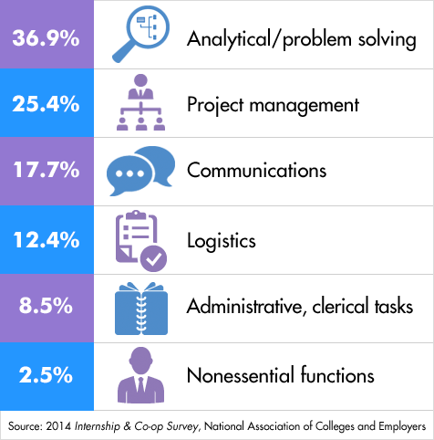
Sample Intern Workday

Slide 28
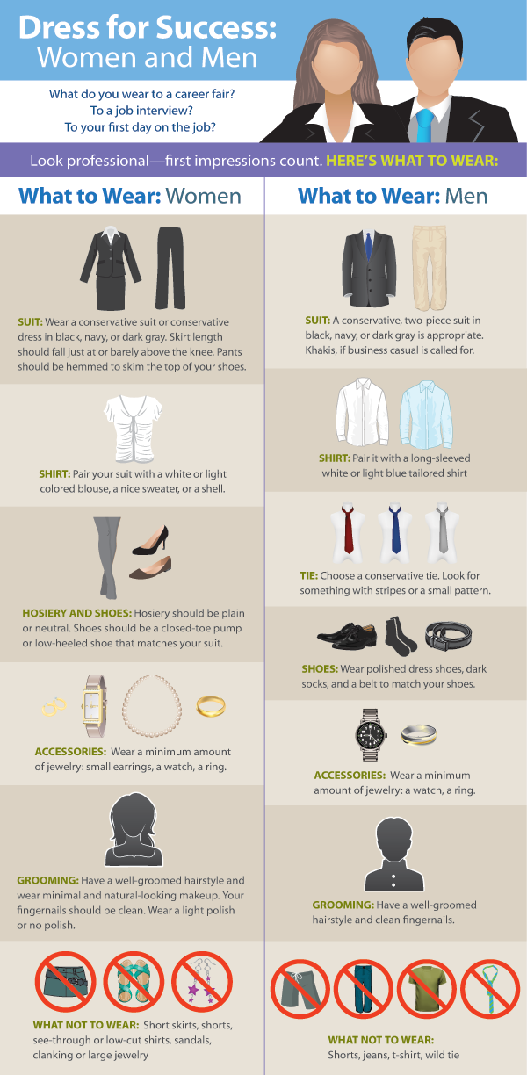
Source: 2014 Grab-N-Go, National Association of Colleges and Employers

Slide 29
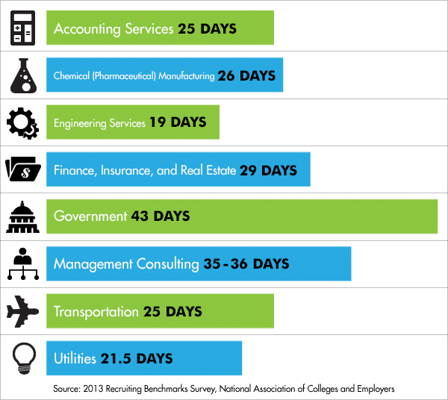
Response Time after Interviewing

Slide 30
The Job Offer
Research salaries in region for that position
www.salary.com, www.payscale.com, www.glassdoor.com, etc…
Research cost of living at www.nerdwallet.com
Take at least 24 hours to consider the offer
Discuss with your mentor
Keep refining your career search process over a lifetime.

Slide 31
Closing Remarks
Career Services is located in Niswonger # 307
Robin Lay can be reached by email and phone (unless in a meeting) from 9am to 5pm, most weekdays.
Drop In Hours: 3pm-4:30pm, most weekdays.
Email: rlay@tusculum.edu
Office Phone: 423.636.7447
Cell Phone: 423.444.5105

